Slide 1

Securing understanding of factors, multiples, squares and cubes
Task A: Multiplication tables to identify multiples
Here is a 6 by 6 multiplication table. Answer true or false to each statement providing a justification for your answer.
✖ | 1 | 2 | 3 | 4 | 5 | 6
1 | 1 | 2 | 3 | 4 | 5 | 6
2 | 2 | 4 | 6 | 8 | 10 | 12
3 | 3 | 6 | 9 | 12 | 15 | 18
4 | 4 | 8 | 12 | 16 | 20 | 24
5 | 5 | 10 | 15 | 20 | 25 | 30
6 | 6 | 12 | 18 | 24 | 30 | 36
Statement | True | False | Justification
a) 12 is a factor of 4 |  |  | 12 is a multiple of 4 or 4 is a factor of 12
b) 36 is a multiple of 3 |  |  | 3 ✕ 12=36 or 36 is a multiple of 3
c) All the multiples of 6 can be seen in this table |  |  | There are an infinite number of multiples

Slide 2
Securing understanding of factors, multiples, squares and cubes
2) Using a 12 by 12 multiplication table:
✖ | 1 | 2 | 3 | 4 | 5 | 6 | 7 | 8 | 9 | 10 | 11 | 12
1 | 1 | 2 | 3 | 4 | 5 | 6 | 7 | 8 | 9 | 10 | 11 | 12
2 | 2 | 4 | 6 | 8 | 10 | 12 | 14 | 16 | 18 | 20 | 22 | 24
3 | 3 | 6 | 9 | 12 | 15 | 18 | 21 | 24 | 27 | 30 | 33 | 36
4 | 4 | 8 | 12 | 16 | 20 | 24 | 28 | 32 | 36 | 40 | 44 | 48
5 | 5 | 10 | 15 | 20 | 25 | 30 | 35 | 40 | 45 | 50 | 55 | 60
6 | 6 | 12 | 18 | 24 | 30 | 36 | 42 | 48 | 54 | 60 | 66 | 72
7 | 7 | 14 | 21 | 28 | 35 | 42 | 49 | 56 | 63 | 70 | 77 | 84
8 | 8 | 16 | 24 | 32 | 40 | 48 | 56 | 64 | 72 | 80 | 88 | 96
9 | 9 | 18 | 27 | 36 | 45 | 54 | 63 | 72 | 81 | 90 | 99 | 108
10 | 10 | 20 | 30 | 40 | 50 | 60 | 70 | 80 | 90 | 100 | 110 | 120
11 | 11 | 22 | 33 | 44 | 55 | 66 | 77 | 88 | 99 | 110 | 121 | 132
12 | 12 | 24 | 36 | 48 | 60 | 72 | 84 | 96 | 108 | 120 | 132 | 144
a) Find the largest multiple of 7
b) Find the largest multiple of 3
c) Find the largest multiple of 5
d) Find the lowest multiple of 3 and 5
84
144
120
15

Slide 3
Securing understanding of factors, multiples, squares and cubes
Task B: Multiplication tables to identify factors
Using an 8 by 8 multiplication table, find:
all the factors of 8
all the factors of 5
all the factors of 4
all the factors of 7
What is their common factor?
✖ | 1 | 2 | 3 | 4 | 5 | 6 | 7 | 8
1 | 1 | 2 | 3 | 4 | 5 | 6 | 7 | 8
2 | 2 | 4 | 6 | 8 | 10 | 12 | 14 | 16
3 | 3 | 6 | 9 | 12 | 15 | 18 | 21 | 24
4 | 4 | 8 | 12 | 16 | 20 | 24 | 28 | 32
5 | 5 | 10 | 15 | 20 | 25 | 30 | 35 | 40
6 | 6 | 12 | 18 | 24 | 30 | 36 | 42 | 48
7 | 7 | 14 | 21 | 28 | 35 | 42 | 49 | 56
8 | 8 | 16 | 24 | 32 | 40 | 48 | 56 | 64
1,8,2 and 4
1, 2 and 5
1, 2 and 4
1 and 7
1
2) Using a 6 by 6 multiplication table, answer true or false to each statement providing a justification for your answer.
Statement | True | False | Justify
a) 4 only has three factors |  |  | 1,2 and 4
b) All the factors of 6 are seen |  |  | 1, 6, 2 and 3
c) 3 has an infinite number of factors |  |  | 1 and 3
d) There are five square numbers seen |  |  | 1, 4, 9, 16, 25 and 36
✖ | 1 | 2 | 3 | 4 | 5 | 6
1 | 1 | 2 | 3 | 4 | 5 | 6
2 | 2 | 4 | 6 | 8 | 10 | 12
3 | 3 | 6 | 9 | 12 | 15 | 18
4 | 4 | 8 | 12 | 16 | 20 | 24
5 | 5 | 10 | 15 | 20 | 25 | 30
6 | 6 | 12 | 18 | 24 | 30 | 36

Slide 4
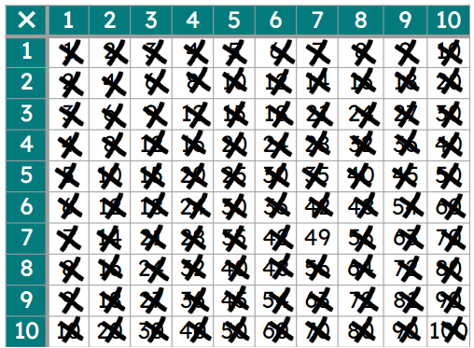
Securing understanding of factors, multiples, squares and cubes
3) What number is remaining when you eliminate:
all the multiples of 5?
all the factors of 24?
all the multiples of 3?
all the multiples of 4?
all the factors of 14?
Mathematics in Education and Industry
v2.2

